Slide 1
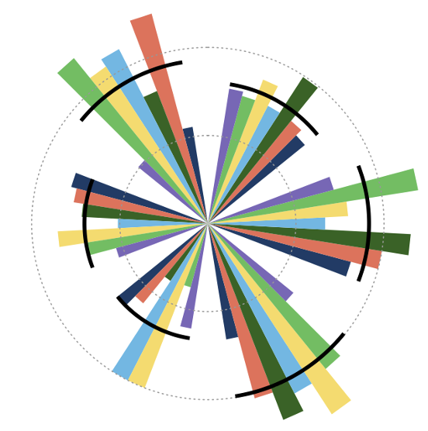
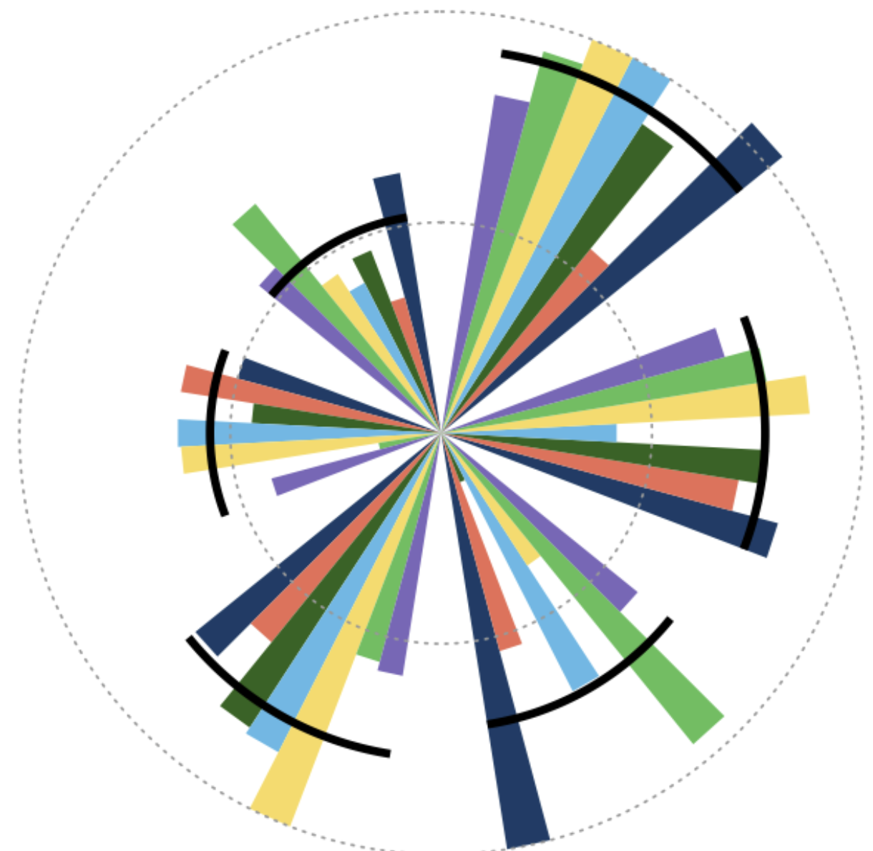

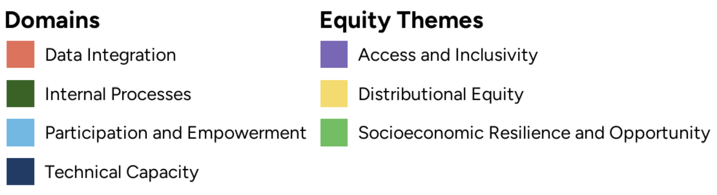

[EQuiPD]
City Report
Equity in Air Quality
Policy & Data Ecosystem
A
D
United States – Pittsburgh
City/institutional buy-in & capacity building (1.8)
This is an area of relative strength for Pittsburgh across most domains and equity themes. Data integration is one domain where focused efforts could produce advances in equity. Specifically, improving the processes around integrating community characteristics (e.g., race, income, age) into air quality evaluations to assess potential health and economic disparities. Tracking these features over time will allow for understanding whether disparities are narrowing over time as new air quality policies are shaped. Strengthening the evaluation process will also amplify access and inclusivity.
Data-sharing partnerships & management tools (1.5)
Data sharing partnerships in Pittsburgh are developing but have gaps specifically in the domain of Participation and Empowerment. A key reason for this gap focuses on data gaps and engagement from disadvantaged communities. Engaging disproportionately impacted communities in developing data tools for tracking hyper-local air pollution sources or job markets and economic changes tied to air quality policies have the potential to improve attainment in this category.
Source & emission inventories (1.4)
Pittsburgh is in an introductory phase towards understanding equity aspects around the source of air pollution in the city. While there is detailed understanding and historical data of general emission sources (e.g., generation and mobility), there is less knowledge or process attempting to integrate and derive the distributional equity in exposure to these sources. As a result, there is unlikely a process in place to understand if a new emission source would lead to more or less disparity with regards to air pollution and its downstream effects.
Estimating air pollution (1.5)
Pittsburgh benefits from national air quality modeling programs that deliver high quality resources and data. However, they acknowledge a lack of technical capacity to overcome gaps among communities with data sparsity and data linkages to understand how air quality correlates with housing, energy, and workforce measures. Next steps to support future policy endeavors would be to coordinate among city offices and partners with health, housing, energy, and economic datasets and begin developing strategies to integrate these data sources.
Health and economic impact modeling (1.1)
Although Pittsburgh has made progress in estimating air pollution across the city and gathered basic health datasets, there is a clear gap in its ability to integrate measures of equity into health and economic models using this data. There are two main recommendations that would advance this category. First, to develop basic capacity around impact modelling of health and economic outcomes, and second, to begin to disaggregate these analyses along neighborhood or individual-level characteristics. Being able to model impacts of air quality on these outcomes will allow for a baseline measurement to quantify the impacts of new policy and adapt when policy does not have the intended effects.
Public support and engagement (1.0)
Developing processes and data around public engagement with respect to air quality is both challenging and essential. Perhaps most important is reaching out to vulnerable communities and those most impacted by air pollution. This is especially important with respect to health, but equally to understand how local economies adapt and respond to air quality interventions. Building public support could begin identifying data gaps among vulnerable communities and reaching out to these areas to build engagement. This will not only support future policy initiatives and educate on the impacts of air quality, but also to ensure distributional equity in the intended outcomes of future air quality programs.
A
F
E
B
E
B
C
D
Radar plot legend (score)
C
F
(1.2)
(1.3)
(1.3)
(1.5)
(1.2)
(1.6)
Implementation Scoring Guide: None Limited Partial Full
0 1 2 3
(1.4)

Slide 2
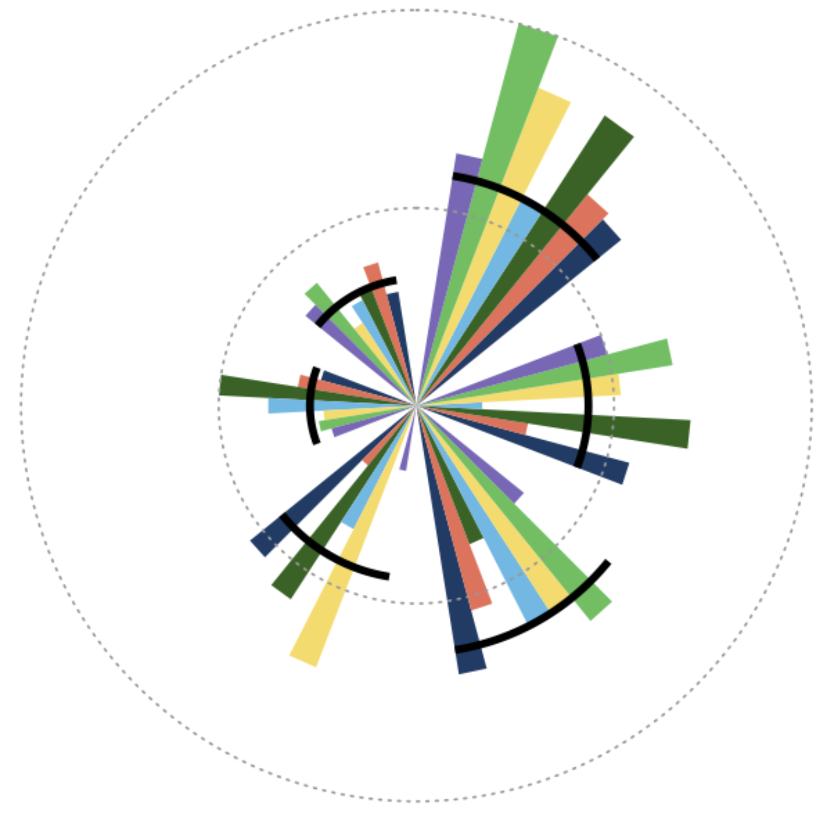
[EQuiPD]
City Report
Equity in Air Quality
Policy & Data Ecosystem
City/institutional buy-in & capacity building (1.2)
City buy-in is an area of relative strength for Durban. They have processes for sharing air quality, health and economic data with relevant city officials and establish systems in place for collaboration both within governmental offices and communities. Employing individuals with expertise in air quality modeling and health or economic impact analyses would make the best use of the available resources to bring Durban to the next level here and in several other categories. Considering partnerships with NGOs or academic organizations to help supply and inform the knowledge base or develop a data council could also provide long-term support.
Data-sharing partnerships & management tools (0.9)
Developing partnerships to incorporate a broad range of city data is critical for equitable air quality policy. Durban currently lacks high resolution health and labor market data which has the potential to provide detailed information on disparities related to air quality. Strengthening data sharing partnerships through formal agreements with data providers and including these providers in the overall efforts will create mutual motivation and responsibility when it comes to implementing and maintaining clean air actions. When these data sources are available, enlisting data engineering teams to develop and maintain data pipelines for harmonizing data will provide the foundation for more in depth knowledge to be extracted related to city-wide equity.
Source & emission inventories (1.3)
Emission inventories is another area where Durban has made progress towards implementation. Their partnerships with transportation, agricultural, and industry sectors can provide detailed data on emission sources. As Durban begins to develop exposure models, this information can be incorporated to improve the quality of the outputs. Additionally, linking emission information with demographic data will allow for disparities to be directly highlighted and lead to development of targeted clean air actions.
Estimating air pollution (0.9)
Durban collects high resolution air quality and meteorological data required for effectively estimating air pollution across the city. Required technical and data integration abilities are lacking to take this data and make it relevant for use in models and policy insights. Developing modeling capacity using data fusion and exposure modeling techniques will provide usable resources for a variety of other equity focused policy indicators. Once modeling capacity is established, overlaying demographic data on exposure maps will provide insight into air quality inequities across the city.
Health and economic impact modeling (0.5)
Impact modeling is an area where Durban has potential for growth. A first step here would be to begin collecting basic health outcome and economic transition information across the city. This includes items such as asthma incidence or early mortality, household energy usage, and green jobs. Harmonizing this data with temporally relevant air quality information will put in place the basic requirements to proceed with health and economic modeling related to air pollution. Once this is in place, further disaggregating data across demographic and socioeconomic factors will allow for further refined analyses to take place.
Public support and engagement (1.0)
Durban in in an introductory phase related to engaging public in air quality efforts across the city. They have made progress related to assessing the health or economic costs of policy compliance across communities as well as collecting data that could characterize vulnerable populations. However, they have not begun to use this information to understand inequities that exist. Important next steps include analyzing how environmental burdens differ across communities and providing communication of policy impacts or air quality information through public channels. Targeted outreach to communities most affected by air pollution has the potential to provide early success in engaging representatives from diverse communities across the city.
South Africa – Durban
A
D
A
F
E
B
E
B
D
C
Radar plot legend (score)
F
(0.7)
(1.3)
C
(0.7)
(0.9)
(0.7)
(1.1)
Implementation Scoring Guide: None Limited Partial Full
0 1 2 3
(1.0)

Slide 3
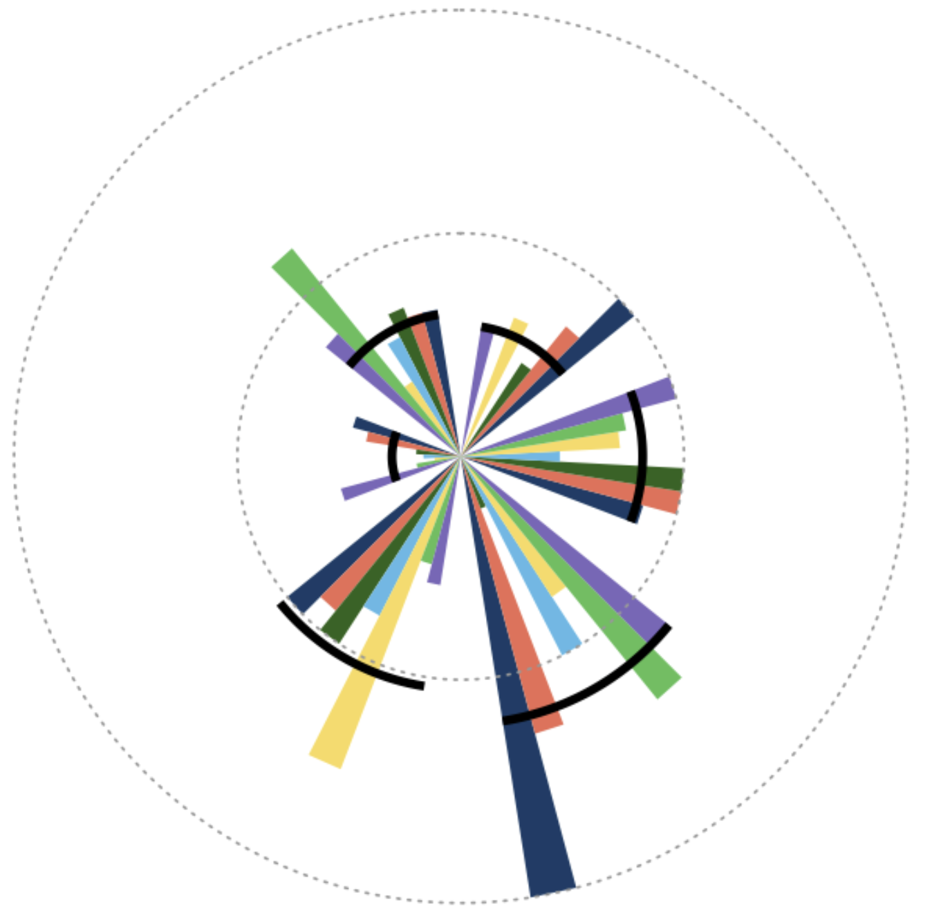
[EQuiPD]
City Report
Equity in Air Quality
Policy & Data Ecosystem
City/institutional buy-in & capacity building (0.6)
Johannesburg is at an early stage of buy-in and capacity building, with some existing commitments to open data access and initial engagement of community partners. These strengths provide a foundation for deeper collaboration and more consistent practice. Next steps include formalizing leadership support (e.g., written policies or dedicated budget lines), creating regular training opportunities for staff and community members on data collection, interpretation, and use, and establishing clear roles for community organizations in decision-making processes. Building structured feedback loops and documenting procedures will help move from ad‑hoc efforts toward a fully implemented, citywide culture of shared learning and data-driven governance.
Data-sharing partnerships & management tools (0.8)
Current efforts around data‑sharing partnerships and management tools show encouraging progress, including relationships with key agencies and basic processes for organizing and accessing datasets. To build on these strengths, the next steps should focus on formalizing data‑sharing agreements, expanding partnerships to include community groups and additional public agencies, and standardizing data formats and metadata to enable smooth integration. Investing in secure, centralized data management tools will help ensure that shared information is timely, comparable across sources, and easily used for analysis and decision‑making.
Source & emission inventories (1.2)
Johannesburg has emissions data with coverage of major point, area, and mobile sources, historical land‑use and zoning data, and open data portals and dashboards that make emissions information publicly accessible. There is early engagement with labor and community stakeholders for initial tracking of smaller or unconventional sources. To move toward full implementation, next steps include formalizing partnerships with key sectors (industry, transportation, agriculture) to routinely update and improve inventories; systematically linking source‑specific emissions to health and economic outcome data; and integrating community‑generated and sensor data to better capture hyper‑local and inequitable exposures.
Estimating air pollution (1.0)
Johannesburg has monitors prioritizing high‑risk communities, high resolution measurements, and access to external datasets such as long‑term monitoring records or meteorological data. Next steps include incorporating community input into siting and expanding the low‑cost and indoor measurements to better capture local source contributions. The city should also formalize procedures for validating model estimates where monitoring is sparse and routinely evaluate before‑and‑after changes in exposure and health risk to ensure methods remain accurate and equity‑focused.
Health and economic impact modeling (0.3)
Johannesburg is at a very early stage of health and economic impact modeling, with some initial capacity to disaggregate labor and economic data to reveal inequities. Next steps are to build core data and methods for robust modeling, which includes linking high‑resolution health and economic data with air quality metrics and estimating health and economic impacts of clean‑air policies, disaggregating results across neighborhood characteristics. Finally, the city should consider before‑and‑after evaluations of major policies, summarizing findings for communities and decision‑makers, and using results to guide investments and regulatory decisions.
Public support and engagement (0.6)
There is a foundation for equity-focused analysis, including neighborhood-level demographic data, some tracking of smaller unconventional emission sources, early evaluation of health and economic impacts of policies, and public-facing data platforms. Next steps include mapping access to clean air spaces, addressing data gaps that may disadvantage certain communities, and providing technical support so community sensor projects can feed into official datasets. Strengthening models with locally collected data, expanding analyses of differential health and economic burdens across groups, and establishing real-time alerts and clear mechanisms to ensure evaluation findings inform policy decisions will help close remaining gaps and deepen equity impacts.
South Africa – Johannesburg
A
D
F
A
E
B
E
B
D
C
Radar plot legend (score)
F
(0.6)
C
(0.7)
(0.3)
(0.9)
(0.6)
(0.7)
Implementation Scoring Guide: None Limited Partial Full
0 1 2 3
(0.6)

Slide 4
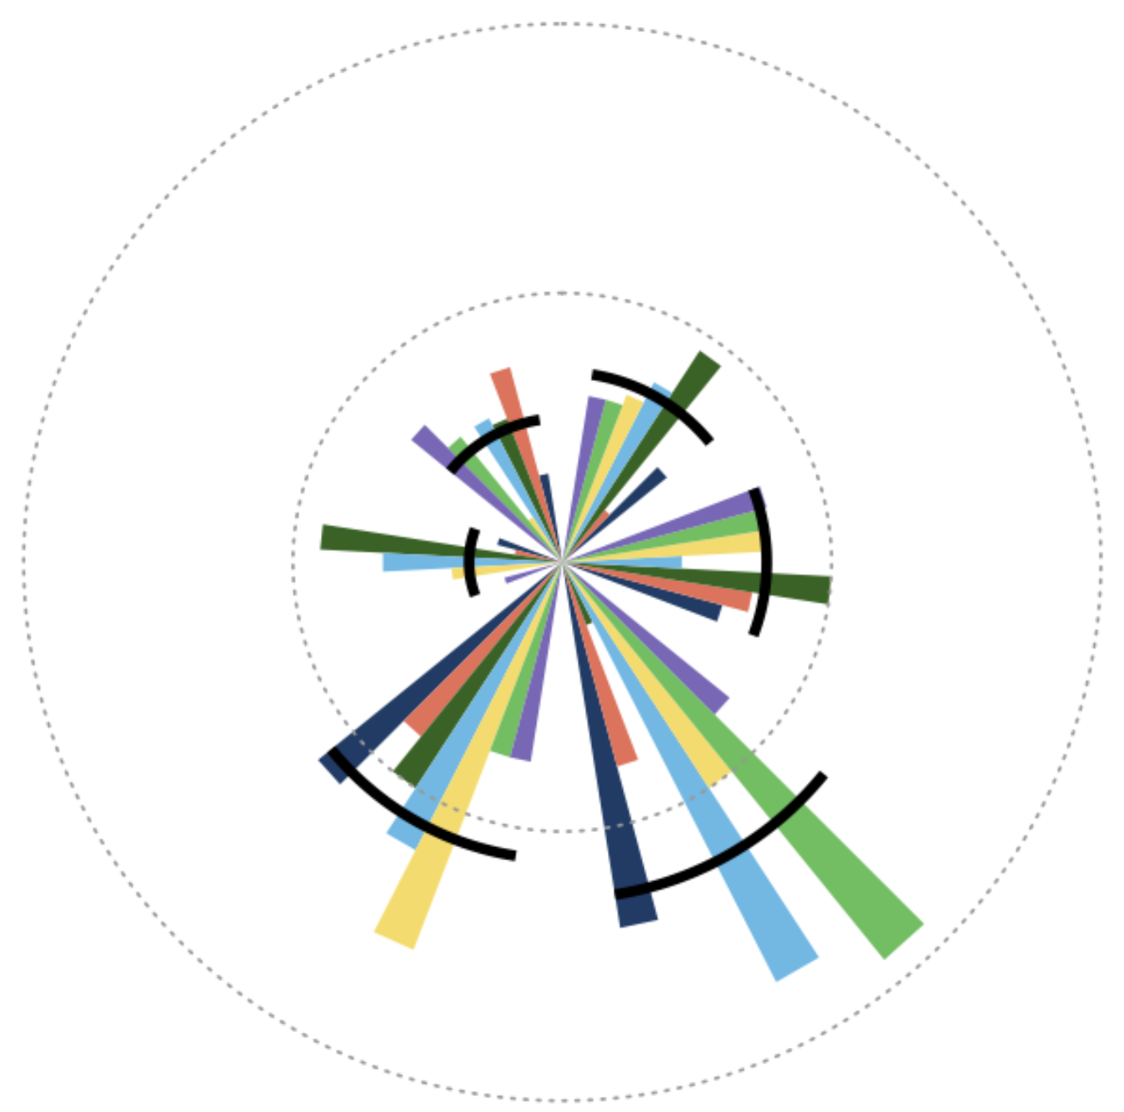
[EQuiPD]
City Report
Equity in Air Quality
Policy & Data Ecosystem
City/institutional buy-in & capacity building (0.7)
Dubai is in the beginning stages of AQ policy implementation, with some cross-departmental coordination, early data-sharing partnerships, and limited support for community sensor projects. Systematic structures and training are still emerging. Next steps include formalizing interdepartmental and intergovernmental agreements, establishing clear roles for data scientist and equity-focused staff, and creating regular training opportunities for both city staff and community partners on data collection, management, interpretation, and data use in decision-making.
Data-sharing partnerships & management tools (0.8)
Strengths related to data-sharing partnerships and management tools include emerging interdepartmental and external agreements, and early use of shared data platforms. These foundations may enable basic linkage of environmental, health, and demographic datasets. Some next steps Dubai may consider are to formalize and expand data-sharing agreements across all relevant departments and higher levels of government, standardize data formats and documentation, and invest in robust, user-friendly management tools (e.g., version control, open-source GIS) to support routine, equity-focused analysis and public reporting.
Source & emission inventories (1.3)
Dubai has implemented tracking of major point, area, and mobile sources and partnerships with some partnerships across key industrial, transportation, and agricultural sectors. Some land-use and zoning history is digitized, and there is initial attention to smaller or unconventional sources. Next steps include building a unified, citywide emissions database, systematically capturing hyper‑local and unpermitted sources through community reporting, and strengthening linkages between emissions, health, and land-use data to better identify inequities and guide policy.
Estimating air pollution (1.1)
Estimating air pollution concentrations is partially in place in Dubai, with some monitors targeted to residential centers, partial access to meteorological and regional air data, some use of satellite‐based modeling where monitors are sparse, and early work to disaggregate exposure by neighborhood and demographics. Work to develop public dashboards and initial model validation are additional strengths. To move towards implementation, the city should expand low‑cost and indoor monitoring, provide calibration support for community sensors, more systematically combine monitor, satellite, and model data, and regularly check model accuracy and exposure patterns for vulnerable groups and before/after major policy changes.
Health and economic impact modeling (0.3)
Dubai is in an early stage of health and economic impact modeling, with some ability to disaggregate labor and economic data and limited use of health outcome and cost information. To move toward implementation, the city should build high‑resolution, linked air quality-health-economic datasets; adopt standard concentration‑response functions; and routinely model policy impacts by country of origin, income, age, and occupation. Establishing before‑and‑after evaluations for major policies, documenting assumptions and sources of uncertainty, and sharing plain‑language results with communities and decision‑makers will make the modeling more robust and actionable.
Public support and engagement (0.5)
Public support and engagement is in beginning stages in Dubai, with some possible mechanisms to share information and involve residents, but efforts are not yet systematic or fully accessible. Current strengths include initial use of public‑facing platforms and alerts, plus emerging partnerships with community groups. Next steps are to co-design tools and messages with diverse residents, expand low‑tech outreach, and create routine feedback loops (e.g., surveys, forums, advisory groups) so community input directly shapes policies and communication strategies.
United Arab Emirates – Dubai
A
D
F
A
E
B
B
E
D
C
Radar plot legend (score)
C
(0.4)
F
(0.8)
(0.7)
(0.7)
(0.5)
(0.8)
Implementation Scoring Guide: None Limited Partial Full
0 1 2 3
(0.8)

